Slide 1
Introduction to
Django-CMS

Slide 2
About me
Computer Science Master Student @ TU Berlin
Python / Django since 2010
First “coding” back in 1999
Notes:
TU Berlin since winter term 2012
Python since first half 2010
Django since second half 2010
joined the ubuntuusers.de web team
started coding in 1999 HTML
started with Pascal
continued with Delphi
moved to PHP
came to Python

Slide 3
What is Django-CMS?
Uses the Django Web framework
Python
Database independent (PostgreSQL, MySQL, …)
Open Source (BSD License)
Backed by a large Swiss company (Divio AG)
Widely used
1010 Forks, 2627 Watchers, 8283 Commits
Notes:
Numbers are from March 12th, 2014 @ 12:30am

Slide 4
What is Django-CMS?
Integrates seamlessly in entire Internet presence
Highly customizable
Plugins
Apps
Menus
Templates / HTML
CSS
Notes:
One of the key concepts of Django-CMS is, that you are not bound to certain layout concepts
Developer oriented
You are expected to code and design your own components
Therefore Plugins, Apps and Menues
No example template

Slide 5
Setting up a
demo application

Slide 6
Installation
# Create a new virtualenv with a project directory
1. $ mkproject -p /usr/bin/python2.7 djangocms-talk
# Install Django, Django-CMS and a few other requirements
2. $ pip install "Django==1.6.2" South psycopg2 Pillow
3. $ pip install -e \
> "git+https://github.com/divio/django-cms.git@fdbccf1086#egg=django-cms"
# Install a few Django-CMS plugins
4. $ pip install djangocms-text-ckeditor djangocms-admin-style \
> djangocms-link
# Create a new Django project
5. $ django-admin.py startproject djangocms_talk .
Notes:
!!!Please take care of the dot at the end, it is there intentionally!!!

Slide 7
Database setup
# We will use PostgreSQL
# Create new database user
1. $ sudo -u postgres createuser -P -S -D -R djangocms_talk
Enter password for new role:
Enter it again:
# Create new database
2. $ sudo -u postgres createdb djangocms_talk

Slide 8
Database configuration
# Configure Django’s database settings
$ vim djangocms_talk/settings.py
DATABASES = {
'default': {
'ENGINE': 'django.db.backends.postgresql_psycopg2',
'NAME': 'djangocms_talk',
'USER': 'djangocms_talk',
'PASSWORD': 'djangocms_talk',
}
}
INSTALLED_APPS = (
…
'south',
)

Slide 9
Create database tables
$ python manage.py syncdb
Syncing...
Creating tables ...
…
You just installed Django's auth system, which means you don't have any superusers defined.
Would you like to create one now? (yes/no): yes
Username (leave blank to use 'markus'):
Email address:
Password:
Password (again):
Superuser created successfully.
Installing custom SQL ...
Installing indexes ...
Installed 0 object(s) from 0 fixture(s)
Synced:
> …
…

Slide 10
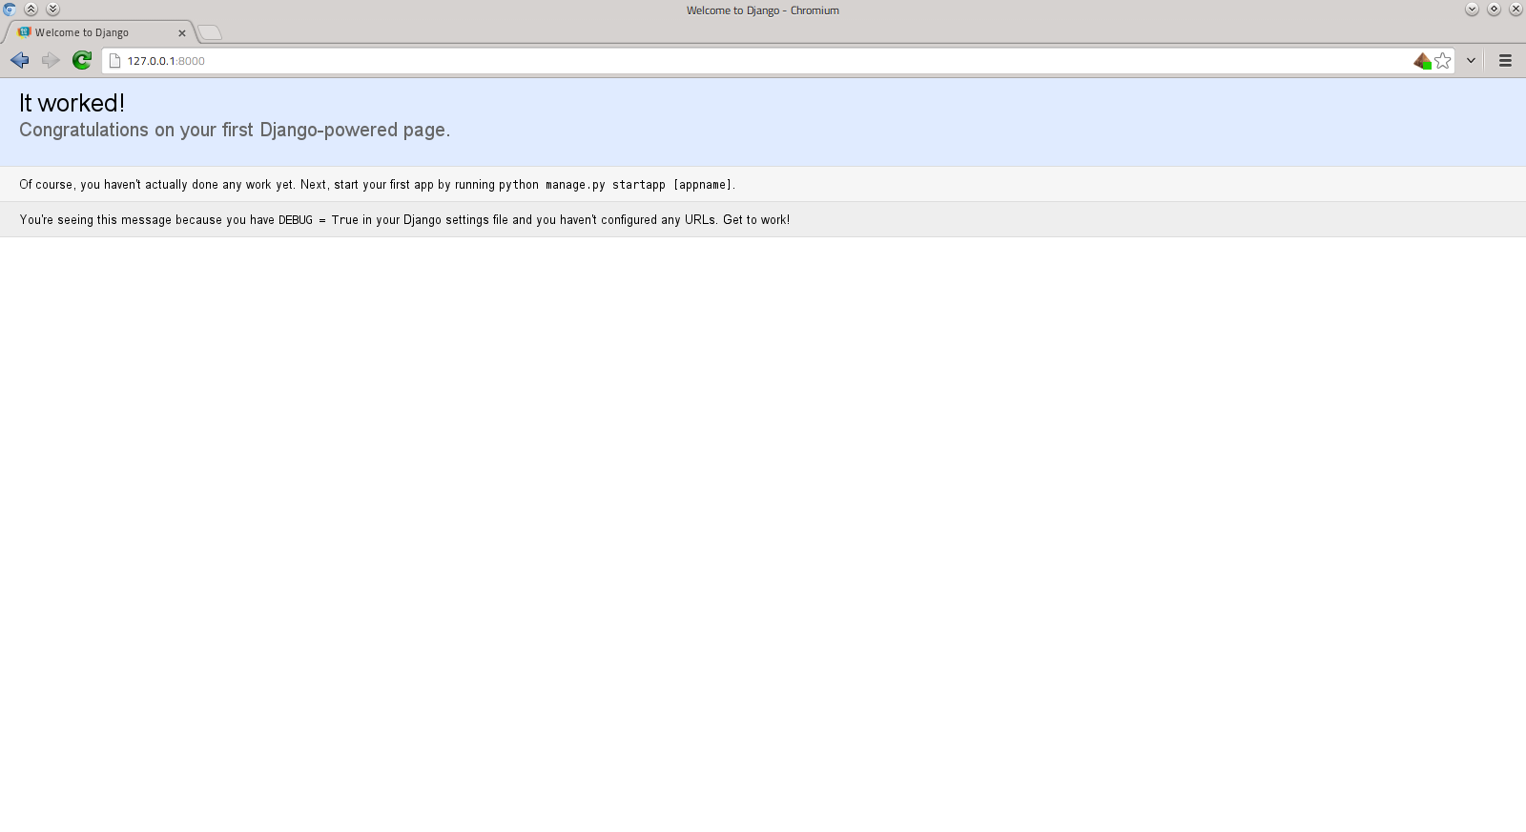
Ready (1)
# Start Django’s development server
$ python manage.py runserver

Slide 11
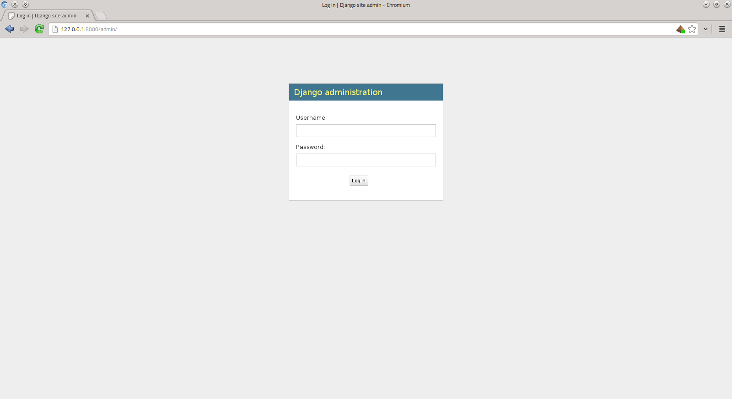
Ready (1)
# Start Django’s development server
$ python manage.py runserver
Notes:
Admin is activated by default form Django 1.6 upwards

Slide 12
Django-CMS configuration (1)
$ vim djangocms_talk/settings.py
# ADD: Absolute path to our project directory
PROJECT_DIR = os.path.join(BASE_DIR, 'djangocms_talk')
# Django-CMS has multi-site support.
# ADD: Site-ID for this site
SITE_ID = 1

Slide 13
Django-CMS configuration (2)
INSTALLED_APPS = (
'djangocms_admin_style', # must be before 'django.contrib.admin'!
'django.contrib.admin', # already there
'django.contrib.auth', # already there
'django.contrib.contenttypes', # already there
'django.contrib.sessions', # already there
'django.contrib.sites',
'django.contrib.messages', # already there
'django.contrib.staticfiles', # already there
'south', # already there
'djangocms_text_ckeditor', # must be before 'cms'!
'djangocms_link',
'cms',
'mptt',
'menus',
'sekizai',
)

Slide 14
Django-CMS configuration (3)
MIDDLEWARE_CLASSES = (
'django.contrib.sessions.middleware.SessionMiddleware', # already there
'django.middleware.common.CommonMiddleware', # already there
'django.middleware.csrf.CsrfViewMiddleware', # already there
'django.contrib.auth.middleware.AuthenticationMiddleware', # already there
'django.middleware.locale.LocaleMiddleware',
'django.contrib.messages.middleware.MessageMiddleware', # already there
'django.middleware.clickjacking.XFrameOptionsMiddleware', # already there
'cms.middleware.page.CurrentPageMiddleware',
'cms.middleware.user.CurrentUserMiddleware',
'cms.middleware.toolbar.ToolbarMiddleware',
'cms.middleware.language.LanguageCookieMiddleware',
)

Slide 15
Django-CMS configuration (4)
# ADD: not part of the project template in Django 1.6, just add them
TEMPLATE_CONTEXT_PROCESSORS = (
'django.contrib.auth.context_processors.auth',
'django.core.context_processors.debug',
'django.core.context_processors.i18n',
'django.core.context_processors.request',
'django.core.context_processors.media',
'django.core.context_processors.static,
'django.core.context_processors.tz',
'django.contrib.messages.context_processors.messages',
'cms.context_processors.cms_settings',
'sekizai.context_processors.sekizai',
)

Slide 16
Django-CMS configuration (5)
# ADD: where to look for static file assets (CSS, JS, Images)
STATICFILES_DIRS = (
os.path.join(PROJECT_DIR, ’static’),
)
# ADD: where to put user uploaded content
MEDIA_ROOT = os.path.join(PROJECT_DIR, ’media’)
# ADD: which URL to use for user uploaded content
MEDIA_ = ’/media/’

Slide 17
Django-CMS configuration (6)
# ADD: where to look for additional template files
TEMPLATE_DIRS = (
os.path.join(PROJECT_DIR, ’templates’),
)
# ADD: which HTML page templates are available for new Django-CMS pages
CMS_TEMPLATES = (
(’start.html’, ’Start page’),
(’content.html’, ’Content page’),
)

Slide 18
Django-CMS configuration (7)
# ADD: which languages will be available within Django-CMS for page translation
LANGUAGES = (
(’en’, ’English’),
)
# CHANGE: default language to use
LANGUAGE_CODE = ’en’
# CHANGE: default timezone to use
TIME_ZONE = ’Europe/Berlin’
Notes:
CMS_LANGUAGES add possibility to define e.g. fallback or redirection / replacement of non-existing pages for given language
http://django-cms.readthedocs.org/en/develop/getting_started/resources/configuration.html#cms-languages

Slide 19
Syncing the database (again)
$ python manage.py syncdb
Syncing...
…
Synced:
> …
Not synced (use migrations):
- djangocms_text_ckeditor
- djangocms_link
- cms
- menus
(use ./manage.py migrate to migrate these)

Slide 20
Migrating the database changes
$ python manage.py migrate
Running migrations for djangocms_text_ckeditor:
- Migrating forwards to 0002_rename_plugin.
> cms:0001_initial
…
- Loading initial data for cms.
Installed 0 object(s) from 0 fixture(s)
Running migrations for menus:
- Migrating forwards to 0001_initial.
> menus:0001_initial
- Loading initial data for menus.
Installed 0 object(s) from 0 fixture(s)

Slide 21
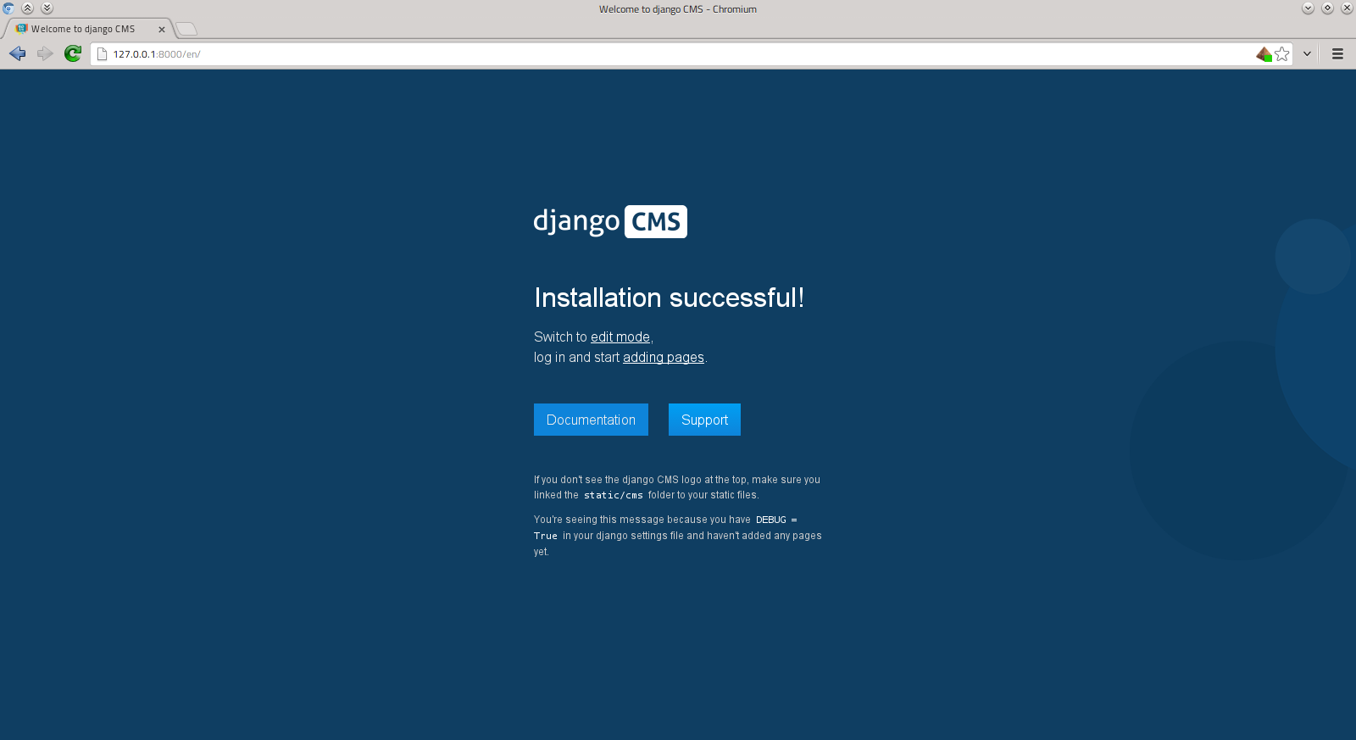
Ready (2)
# Start Django’s development server
$ python manage.py runserver
Notes:
You will see a redirect from http://127.0.0.1/ to http://127.0.0.1/en/

Slide 22
Creating CMS HTML templates
# Create some directories we need later on
1. $ mkdir -p djangocms_talk/{static,media,templates}
# Create HTML template files
2. $ touch djangocms_talk/templates/{base,start,content}.html
{% extends "base.html" %}
{% load cms_tags %}
{% block content %}
<div class="jumbotron">
<div class="container">
{% placeholder jumbotron %}
</div>
</div>
<div class="container">
<div class="row">
<div class="col-lg-4">
{% placeholder col1 %}
</div>
<div class="col-lg-4">
{% placeholder col2 %}
</div>
<div class="col-lg-4">
{% placeholder col3 %}
</div>
</div>
</div>
{% endblock %}
Notes:
“static” -- for static assets, such as css, javascript, design graphics
“media” -- for user uploaded content
“templates” -- where our project wide HTML templates live
Switch back to configuration (6)

Slide 23
Check Django-CMS installation
$ python manage.py cms check
********************************
Checking django CMS installation
********************************
…
OVERALL RESULTS
===============
1 checks skipped!
9 checks successful!
Installation okay

Slide 24
First steps in our new
demo application

Slide 25
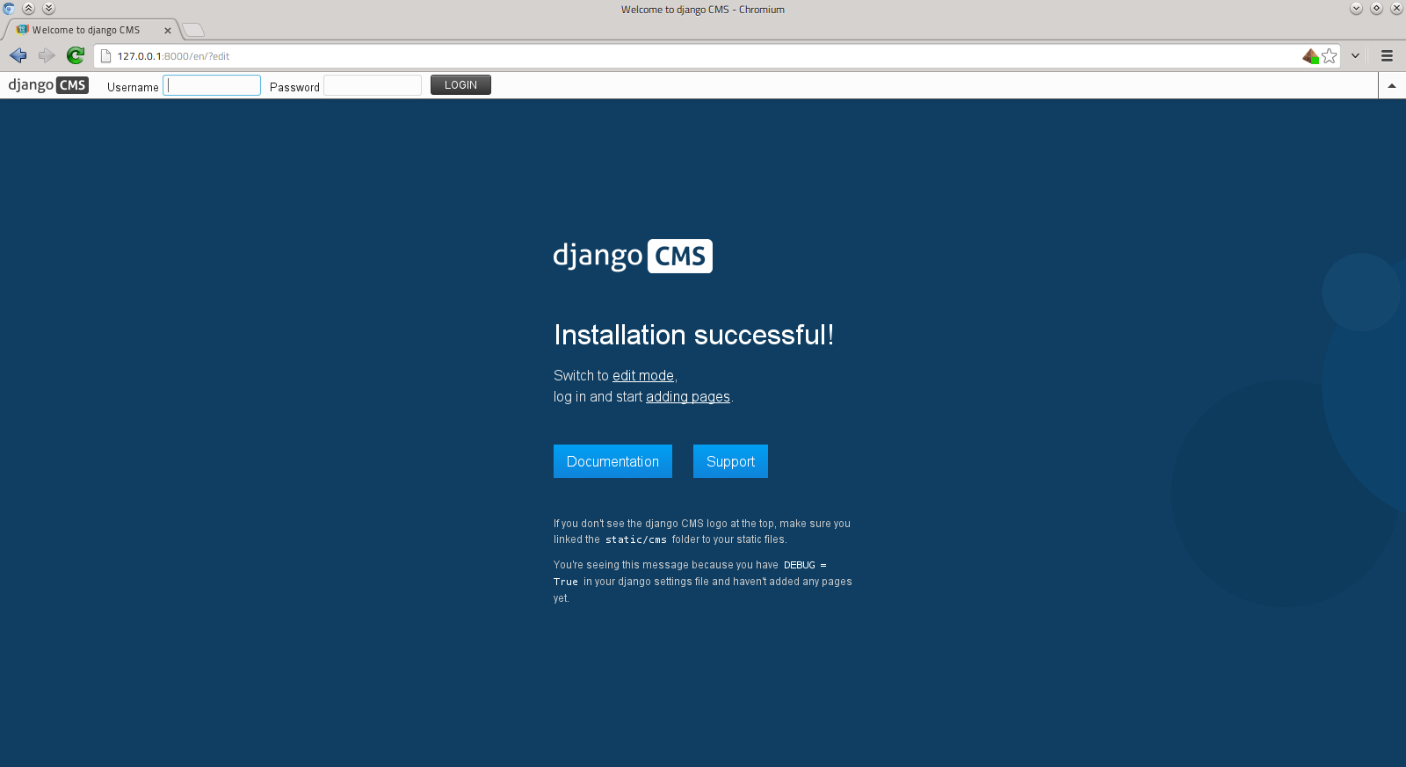
Django-CMS First Steps
Log-in

Slide 26
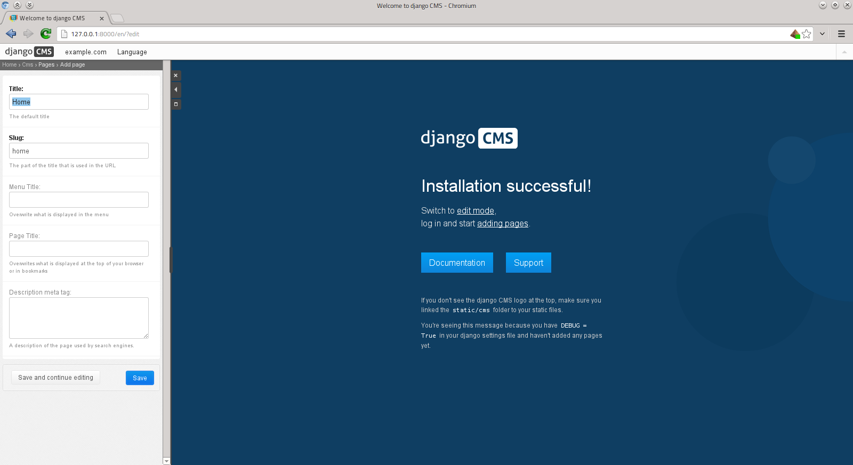
Django-CMS First Steps
Adding a start page

Slide 27
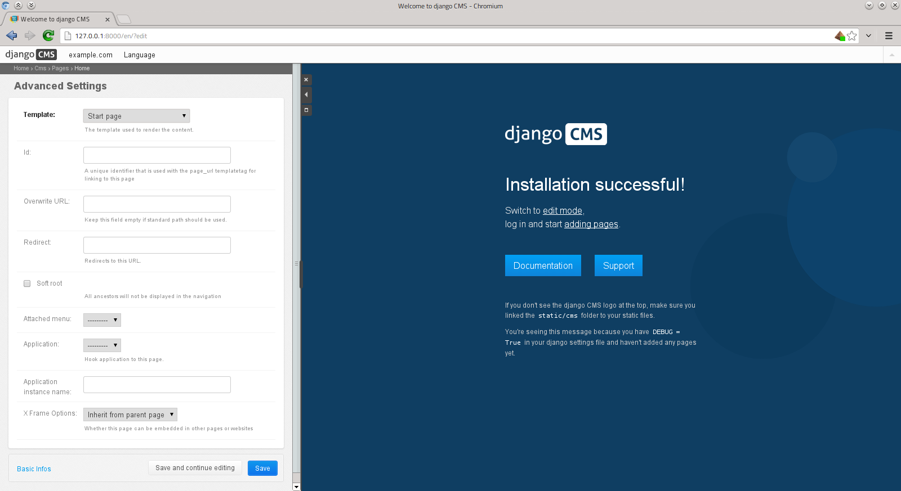
Django-CMS First Steps
Adding a start page

Slide 28
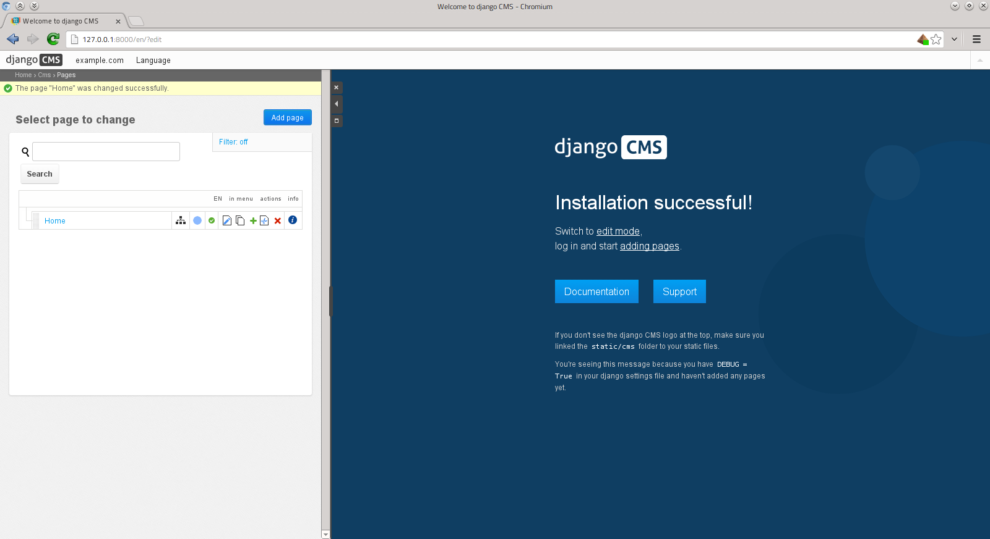
Django-CMS First Steps
Adding a start page

Slide 29
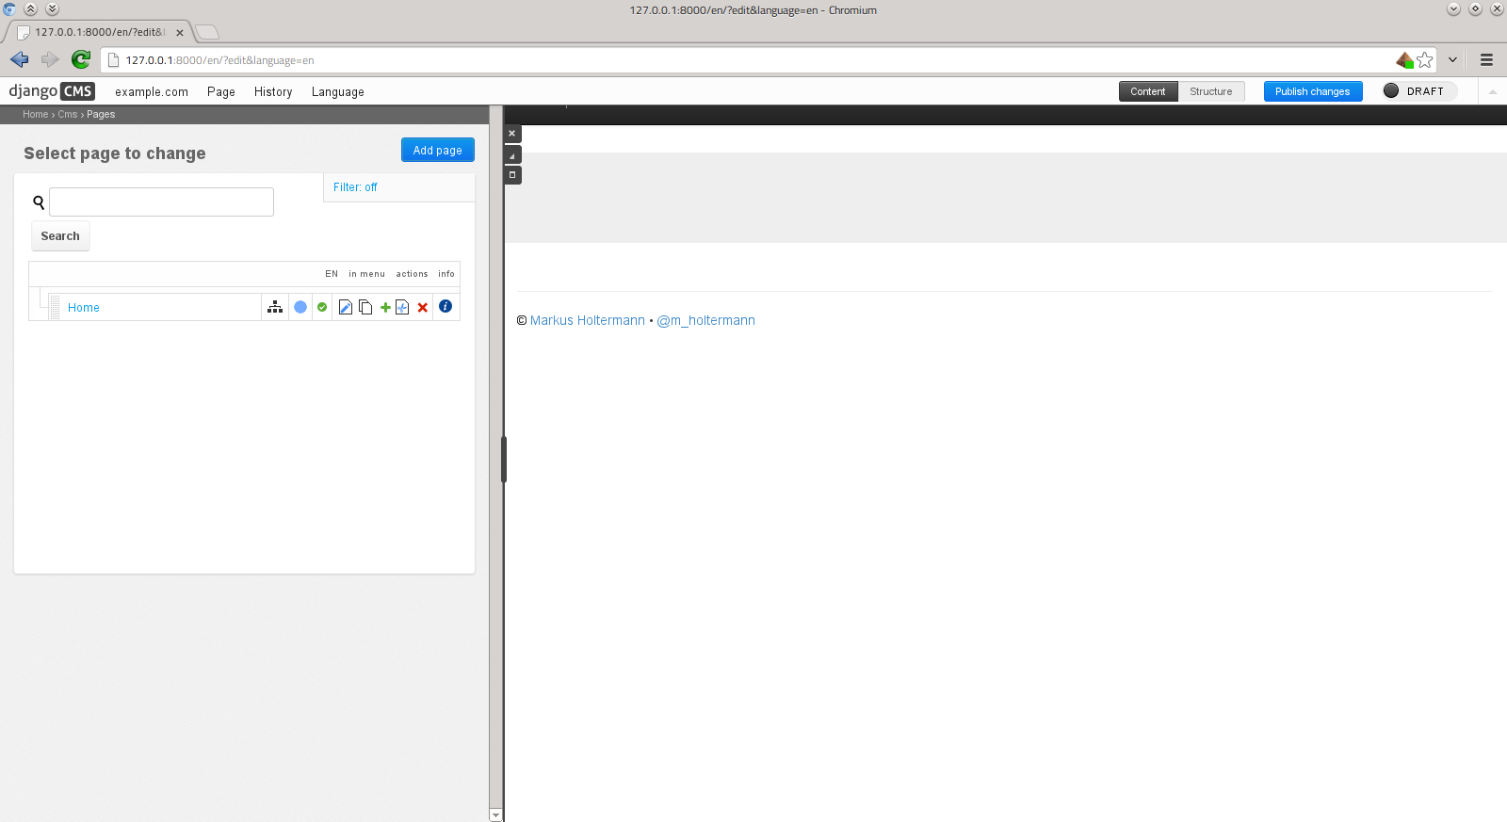
Django-CMS First Steps
Our new start page

Slide 30
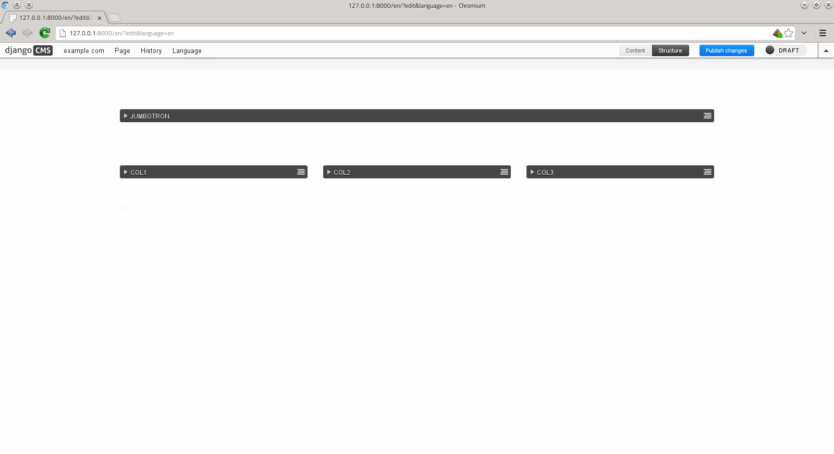
Django-CMS First Steps
Adding content to our page

Slide 31
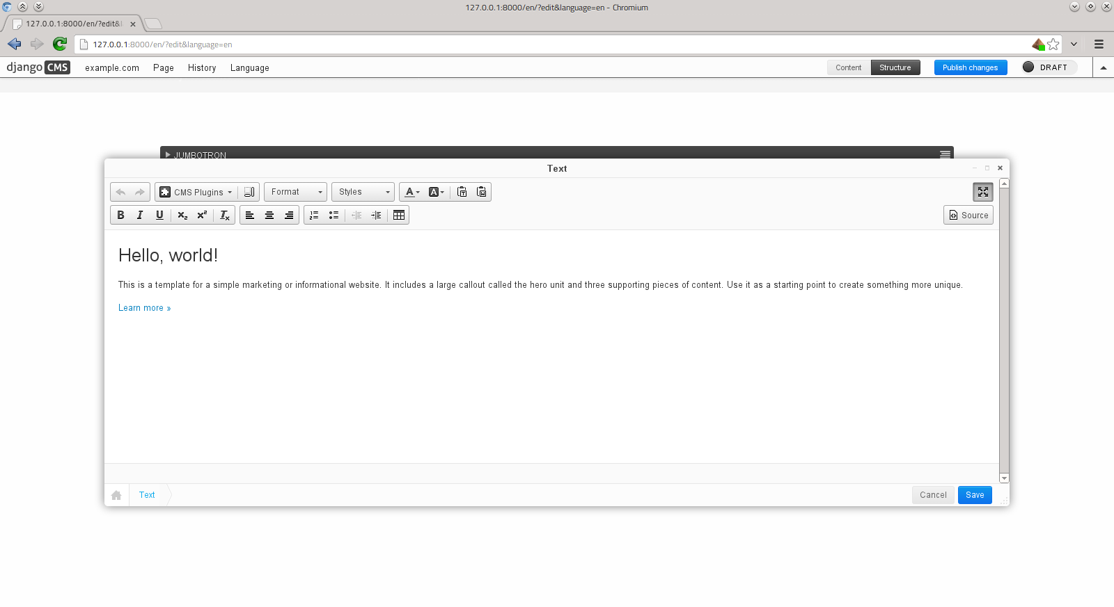
Django-CMS First Steps
Adding content to our page

Slide 32
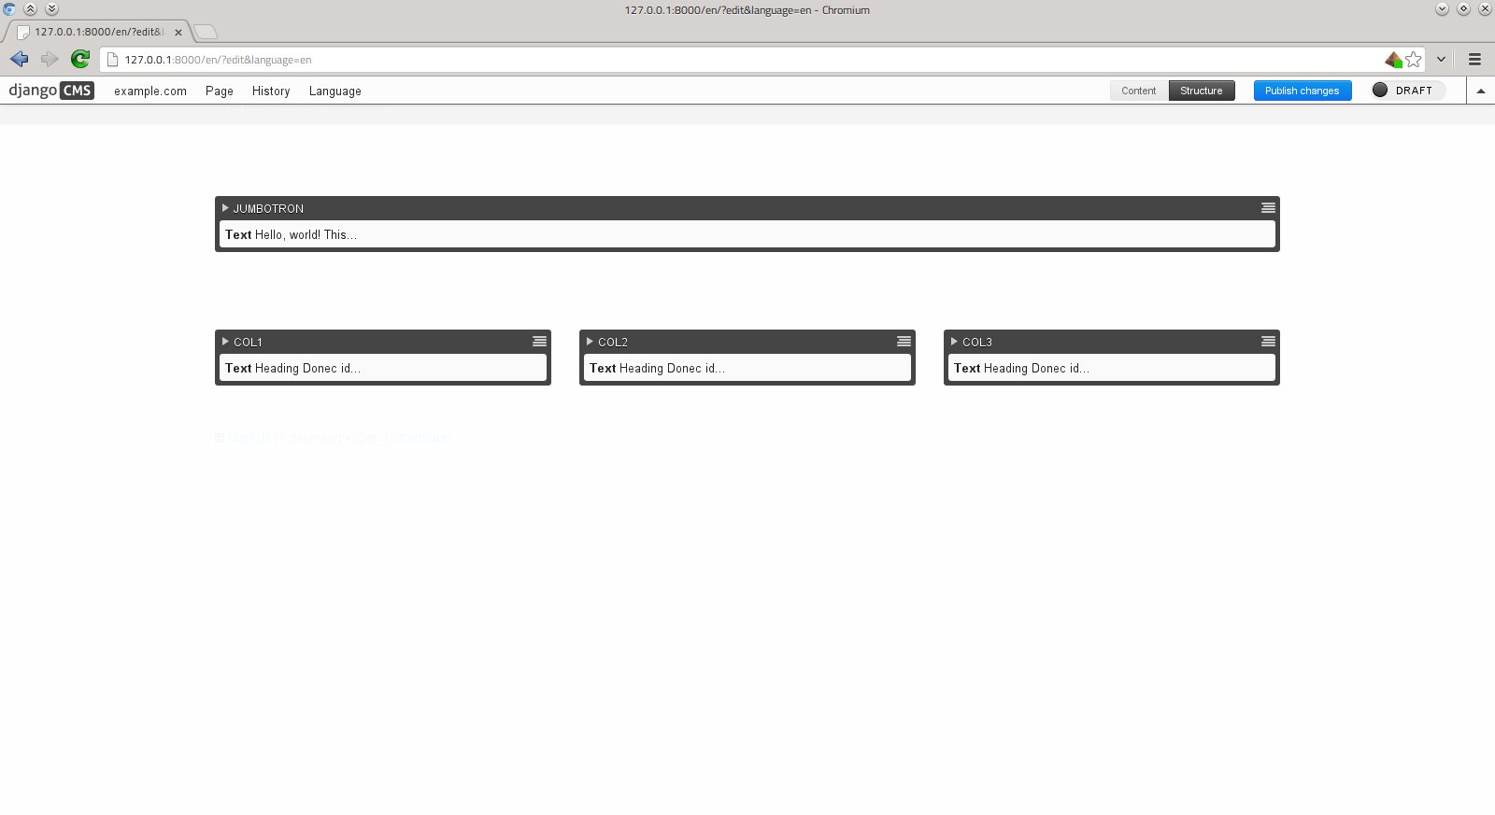
Django-CMS First Steps
Adding content to our page

Slide 33
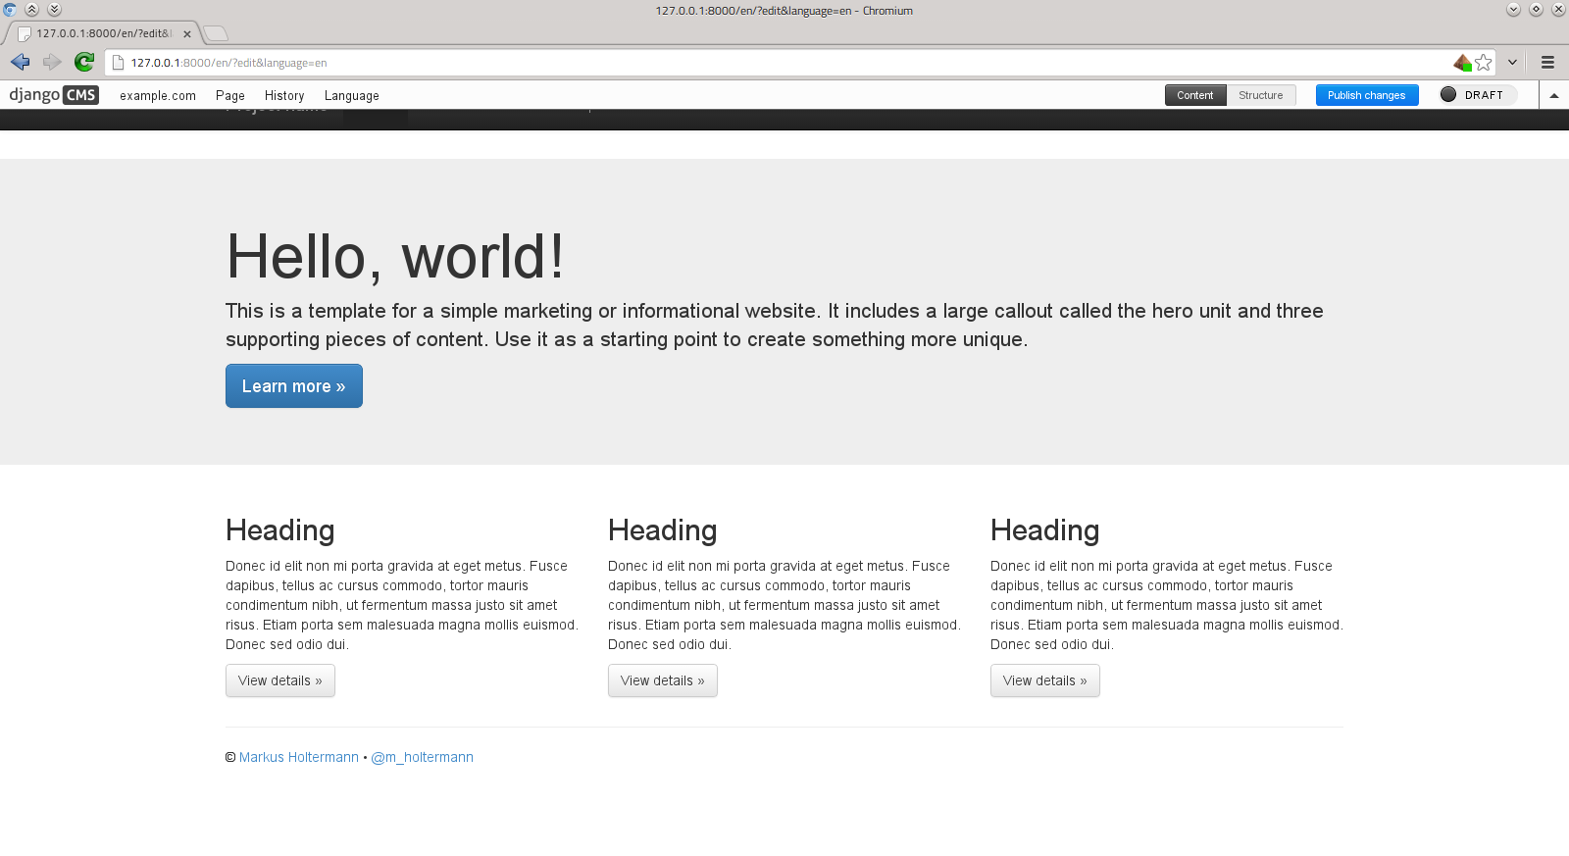
Django-CMS First Steps
The start page is ready

Slide 34
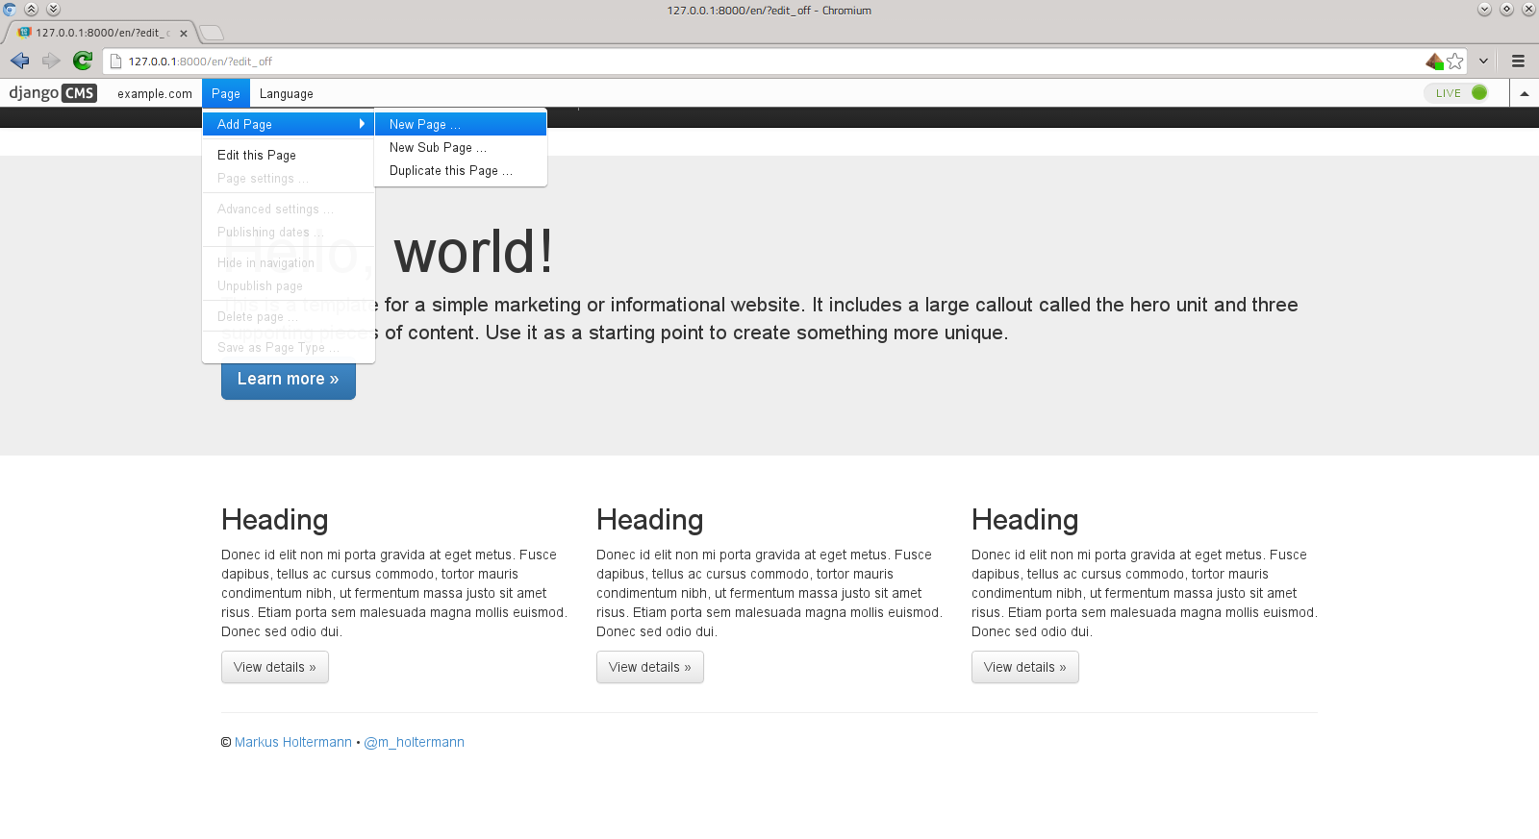
Django-CMS Next Steps
Creating some sub-pages

Slide 35
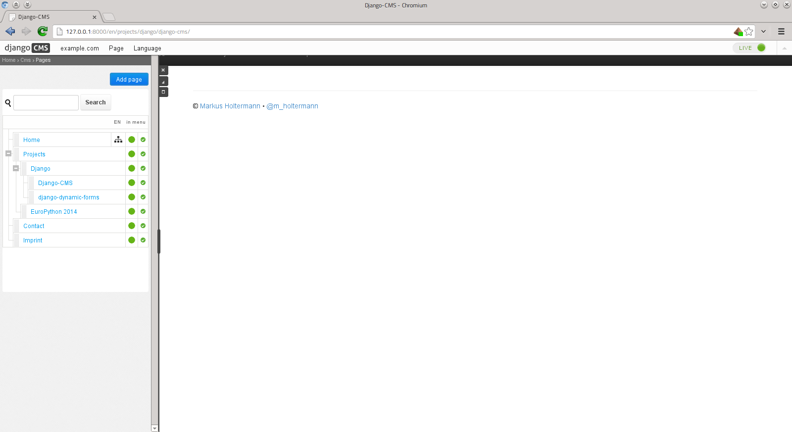
Django-CMS Next Steps
Complex page hierarchy

Slide 36
Django-CMS Next Steps
Getting the page in the menu
show_menu template tag:
{% show_menu 0 100 100 1000 "menu/menu.html" %}
http://django-cms.readthedocs.org/en/develop/advanced/templatetags.html
{% show_menu from_level to_level extra_inactive extra_active "menu/menu_item.html" "" "" child %}
Notes:
"""
render a nested list of all children of the pages
- from_level: starting level
- to_level: max level
- extra_inactive: how many levels should be rendered of the not active tree?
- extra_active: how deep should the children of the active node be rendered?
- namespace: the namespace of the menu. if empty will use all namespaces
- root_id: the id of the root node
- template: template used to render the menu
"""
name = 'show_menu'
template = 'menu/dummy.html'
options = Options(
IntegerArgument('from_level', default=0, required=False),
IntegerArgument('to_level', default=100, required=False),
IntegerArgument('extra_inactive', default=0, required=False),
IntegerArgument('extra_active', default=1000, required=False),
StringArgument('template', default='menu/menu.html', required=False),
StringArgument('namespace', default=None, required=False),
StringArgument('root_id', default=None, required=False),
Argument('next_page', default=None, required=False),
)

Slide 37
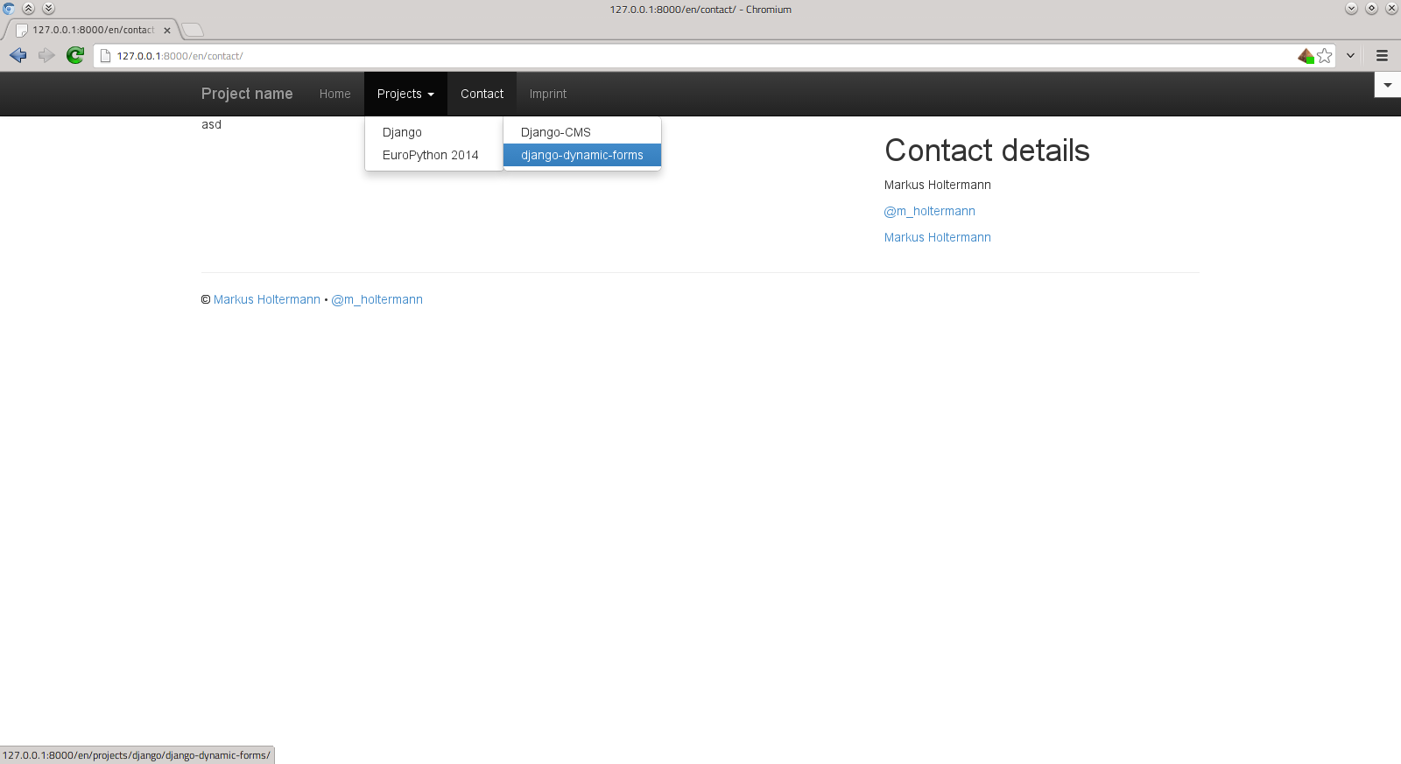
Django-CMS Next Steps
Getting the page in the menu

Slide 38
Demo

Slide 39
Licenses
Django-CMS Logo: https://github.com/divio/django-cms/blob/19d8441a/cms/static/cms/img/logo-white%402x.png
Background Image: https://github.com/divio/django-cms/blob/687f4f8e/cms/static/cms/img/welcome-bg.png
Presentation: Creative Commons CC-BY-SA 3.0

Slide 40
Links
This presentation and code: https://github.com/Markush2010/django-cms-introduction
HTML Boilerplate from Initializr: http://www.initializr.com/
Complex Django-CMS application: https://ep2014.europython.eu/ Code at https://github.com/EuroPython/djep

